Slide 1
IBM Data Science Capstone Project
Opening a restaurant in The Bronx NY
BENMOUSSA Zakaria
20 August 2021

Slide 2
Background
The Bronx NY has been in continuous growth with a population of
1 472 654 residents in 2020.
Goal: Opening a restaurant in the Bronx.
Problem: Selecting an optimal area for a restaurant.
Interest: Investors who are looking to explore different areas in New York City and good neighborhoods for a restaurant.

Slide 3
Data
The list of boroughs and neighborhoods in New York City is provided by the json file from The New York notebook.
Geo-coordinates of the Bronx are provided by the Geocoder tool.
List of venues is provided by the Foursquare API.

Slide 4
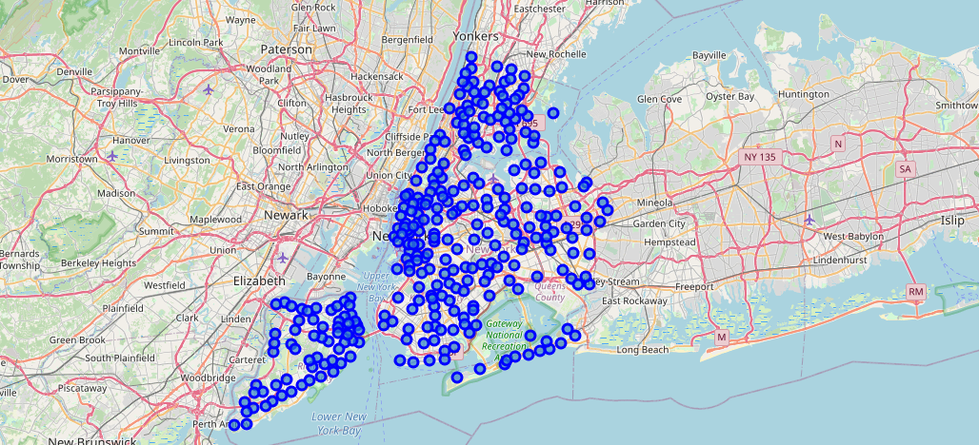
Map of NYC with neighborhoods

Slide 5
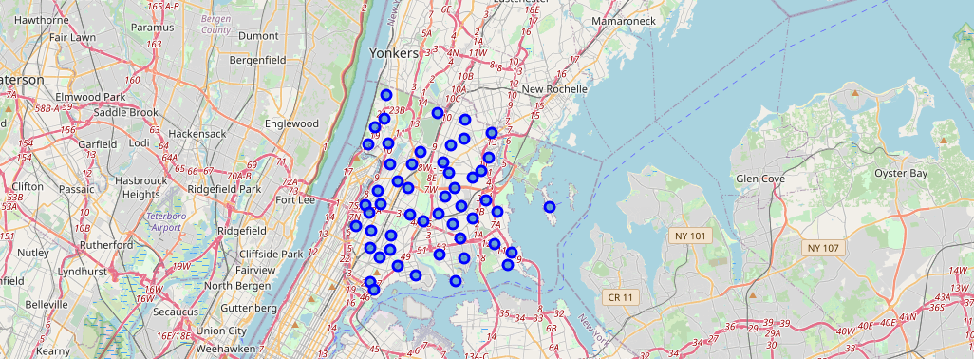
Map of The Bronx borough with neighborhoods

Slide 6
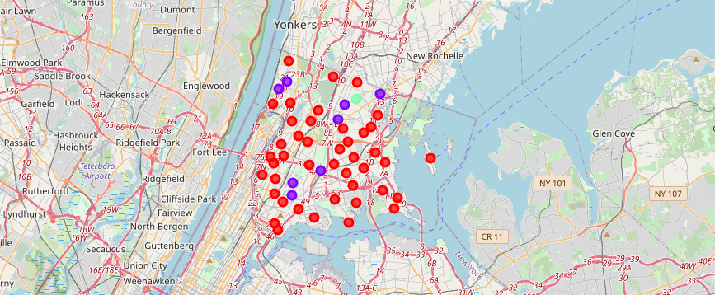
Clusters visualized

Slide 7
Conclusion
Cluster 1 is the most suitable, having neighborhoods with a diverse food, arts and entertainment scene.
Future directions:
*Include more data: average cost of real estate for each neighborhood, characteristics of the residents (age, average income etc.)

